Slide 1



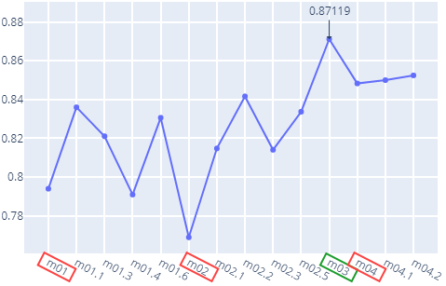
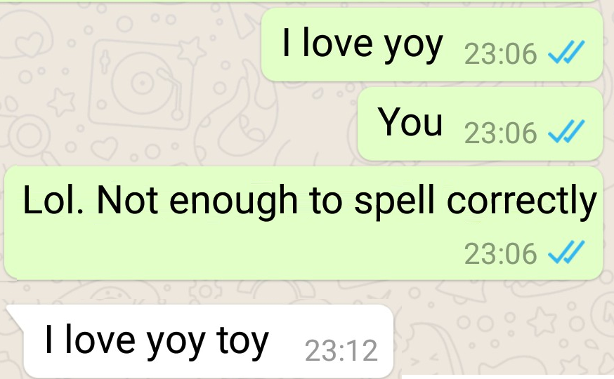
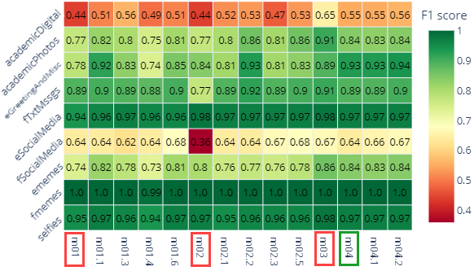

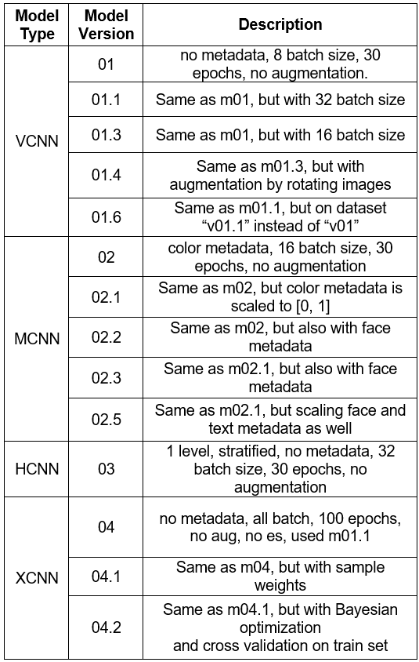
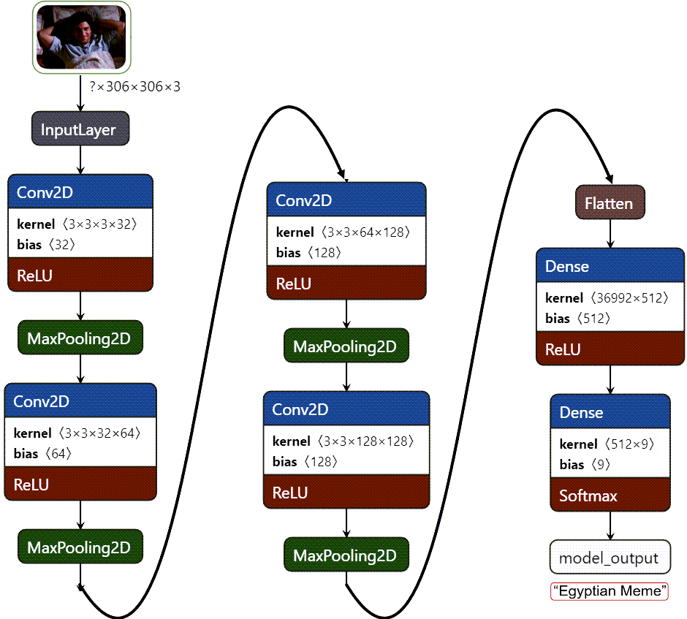
EPIC: Egyptian Personal Image Classifier
By Ashraf Haress, Supervised by Prof. Nahla Barakat
Faculty of ICS,
Department of A.I,
The BUE
Abstract
VCNN
Metadata Extraction
trained
Manually filtering Personal images (PIs) from irrelevant ones (IRIs) on one’s phone gallery can be time consuming, thus a custom dataset was created from social media platforms like Facebook and Reddit, categorized to 9 classes, then trained on variants of CNN models where the hierarchical CNNs yielded the best average f1 score of 0.871.
Feature Description | Value
Num. of faces | 0
Most dominant color | RGB value (“light green”)
Num. of English Words | 14
image Features
XGBoost
Fig 4. XGBoost CNN
(XCNN) Model
Architecture
MCNN
“Egyptian Meme”
Methodology
VCNN
2 Dense Layers
(64 neurons each)
Results
base
Qualitative results were visualised as input, output pairs in the previous pipeline figures. F1-score was used to measure different models (fig 5, 6), such that versions 01.x, 02.x, 03.x, 04.x correspond to VCNN, MCNN, XCNN, and HNN model variants, respectively, and described in Table 1.
Fig 5. Average of Test F1-Scores for Each Model Version
Model types used:
“m01” (VCNN, fig 1) which is a basic convolutional neural network for classification [1]. .
“m02” (MCNN, fig 2) used the same VCNN along with metadata input consisting of image’s features (such as #faces in the image, etc).
“m03” (HCNN, fig 3), which uses multiple VCNNs to classify images in a hierarchical fashion; initially classifying if the image has high or low colour diversity, then classifies its flat class [2]. .
“m04” (XCNN, fig 4), which uses feature representations of images extracted from VCNN as input to XGBoost model.
“Foreign Text Message”
Fig 2. MCNN Model Architecture
VCNN
base
VCNN
image Features
Fig 6. Test F1-Scores for Each Model Version
parent
Conclusion
HCNN
“Many Colors”
(not “Few Colors”)
VCNN
child
Increasing batch size is crucial for optimizing results (m01.1 > m01.3 >> m01)
Cleaning minority classes by removing images does not necessarily improve the score (m01.1 > m01.6)
Normalizing the input helps in improving results due it being a form model regularization (m02.1 > m02)
Breaking down a problem into simpler problems, i.e., hierarchy structure of HCNN, proves beneficial for the model. (m03 > all other models)
Loss of output layer (OL) 0
Agg. Loss
“Egyptian Occasions (greetings, holidays, etc)”
OL 1
Loss
Fig 3. Hierarchical CNN
(HCNN) Model Architecture
References
VCNN has 512-128-64-2 dense layers
VCNN has 512-128-64-9 dense layers
[1]
J. Perez-Martin, B. Bustos, and M. Saldana, “Semantic Search of Memes on Twitter.” arXiv, May 20, 2020. doi: 10.48550/arXiv.2002.01462.
parent
Fig 1. Vanilla CNN (VCNN ) Architecture
S. D. Das and S. Mandal, “Team Neuro at SemEval-2020 Task 8: Multi-Modal Fine Grain Emotion Classification of Memes using Multitask Learning.” arXiv, May 21, 2020. Accessed: Nov. 23, 2022. [Online]. Available: http://arxiv.org/abs/2005.10915
base
child
Table 1. Model Variants’ Descriptions
[2]

